Slide 1
ARTIFICIAL INTELLIGENCE
6CS4 - 05

Slide 2
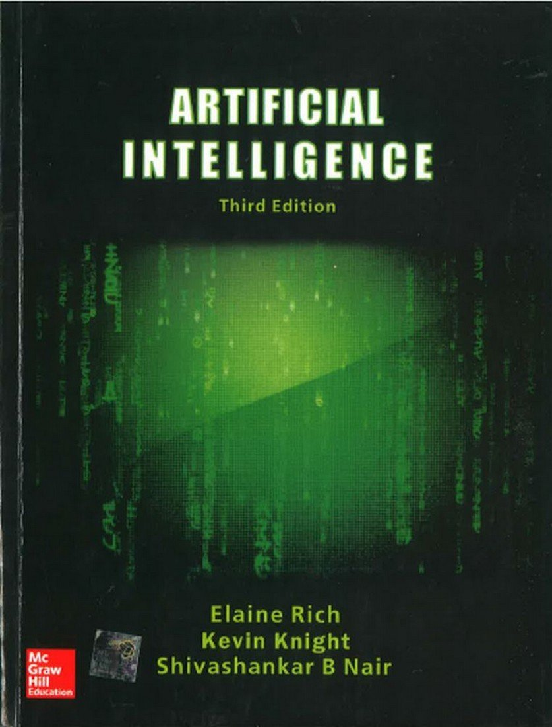
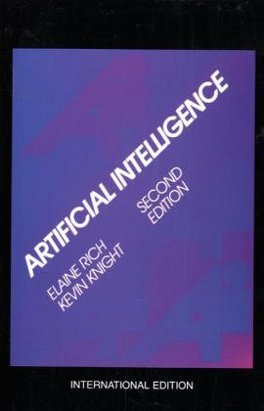

Slide 3
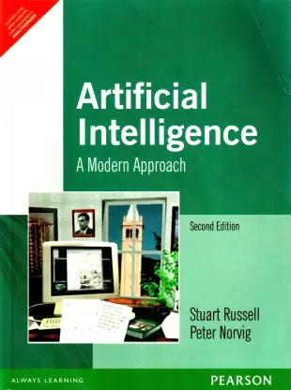

Slide 4
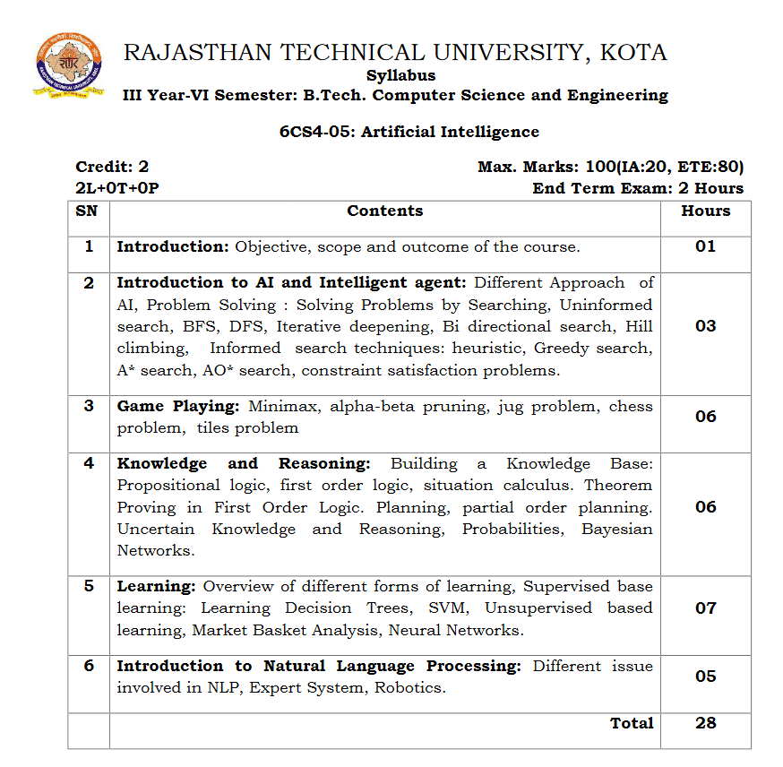

Slide 5
INTRODUCTION
John McCarthy, who coined the term Artificial Intelligence in 1956, defines it as "the science and engineering of making intelligent machines", especially intelligent computer programs.
Artificial Intelligence (AI) is the intelligence of machines and the branch of computer science that aims to create it.
Intelligence is the computational part of the ability to achieve goals in the world. Varying kinds and degrees of intelligence occur in people, many animals and some machines.
AI is the study of the mental faculties through the use of computational models.
AI is the study of : How to make computers do things which, at the moment, people do better.
AI is the study and design of intelligent agents, where an intelligent agent is a system that perceives its environment and takes actions that maximize its chances of success.

Slide 6
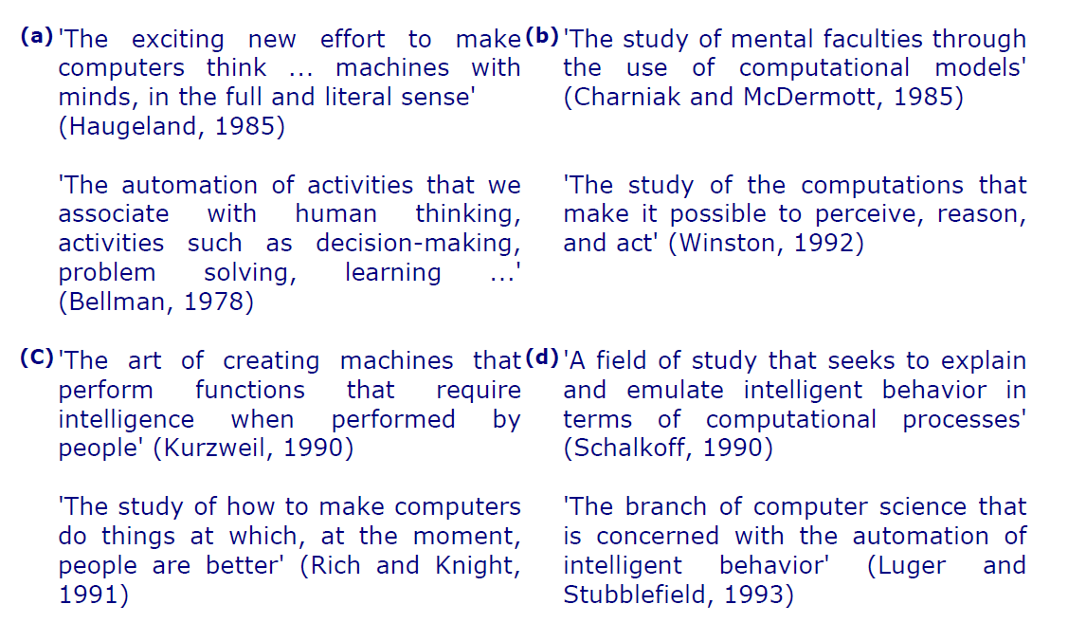
DEFINATIONS OF ARTIFICIAL INTELLIGENCE

Slide 7
INTELLIGENCE
Relate to tasks involving higher mental processes. Examples:
creativity, solving problems, pattern recognition, classification, learning, induction, deduction, building analogies, optimization, language processing, knowledge and many more.
Intelligence is the computational part of the ability to achieve goals.

Slide 8
ARTIFICIAL INTELLIGENCE
MACHINE LEARNING
DEEP LEARNING

Slide 9
EVOLUTIONARY STAGES OF AI
Artificial Narrow Intelligence
Artificial General Intelligence
Artificial Super Intelligence

Slide 10
ARTIFICIAL NARROW INTELLIGENCE (ANI)
It is also known as WEAK AI.
Involves applying AI to specific tasks

Slide 11
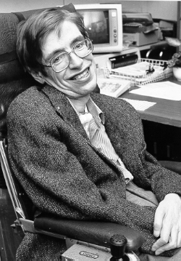
ARTIFICIAL GENERAL INTELLIGENCE (AGI)
It is also known as STRONG AI.
Involves machines the possess the ability to perform any intellectual task that a human being can.

Slide 12
ARTIFICIAL SUPER INTELLIGENCE (ASI)
It is a term referring to the time when the capability of computer will surpass humans.
HYPOTHETICAL SITUATION

Slide 13
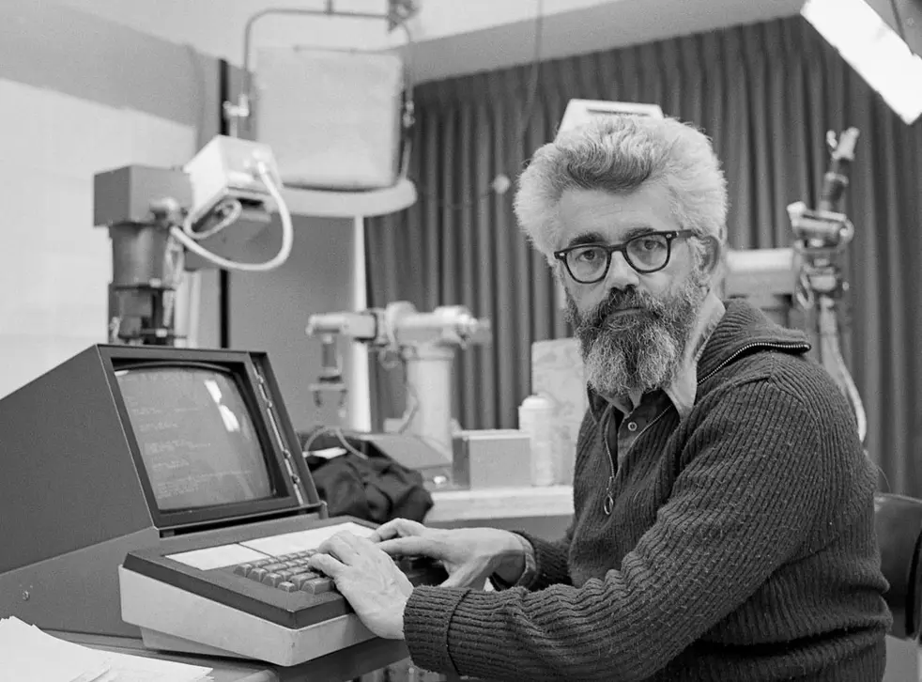
HISTORY OF ARTIFICIAL INTELLIGENCE
TALOS
1950 : ALAN TURING
1951 : GAAME AI
1956: BIRTH OF AI
1959: FIRST AI LABORATORY
1960: GENERAL MOTORS ROBOT
1961: FIRST CHATBOT
1997: IBM DEEP BLUE
2005: DARPA GRAND CHALLENGE

Slide 14
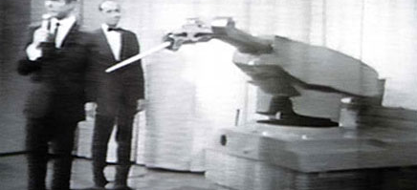
FIRST ROBOT BY GENERAL MOTORS ROBOT
the Unimate was the very first industrial robot. Conceived from a design for a mechanical arm patented in 1954 (granted in 1961) by American inventor George Devol, the Unimate was developed as a result of the foresight and business acumen of Joseph Engelberger - the Father of Robotics.

Slide 15
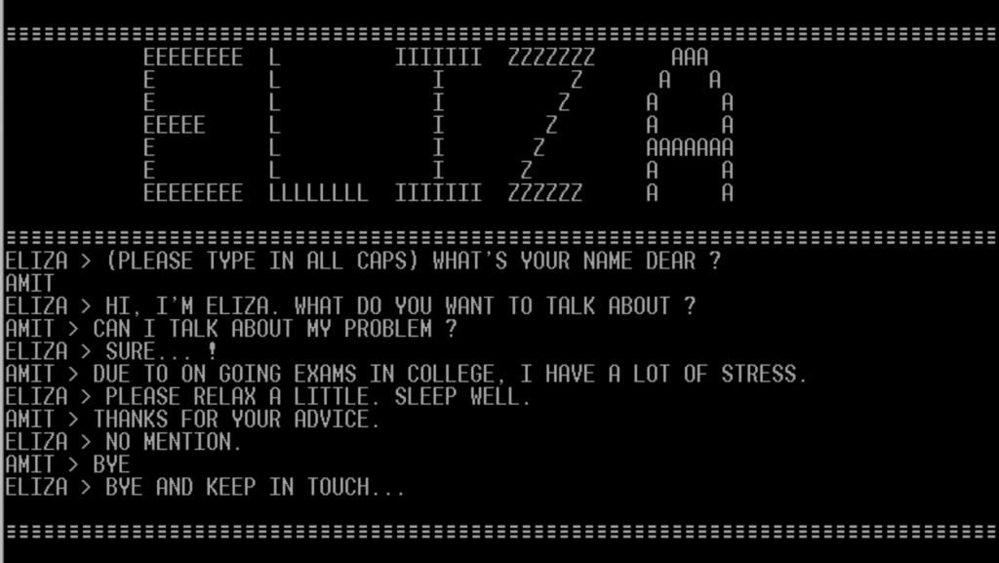
FIRST CHATBOT : ELIZA

Slide 16
DOMAINS OF AI
MACHINE LEARNING
DEEP LEARNING
ROBOTICS
EXPERT SYSTEMS
FUZZY LOGIC
NATURAL LANGUAGE PROCESSING

Slide 17
INTRODUCTION TO AI AND INTELLIGENT AGENT
UNIT 1

Slide 18
APPROACHES TO AI
HUMAN LIKE V/S RATIONAL
SYSTEMS THAT THINK LIKE HUMANS (COGNITIVE SCIENCE) | SYSTEMS THAT THINK RATIONALLY (LAWS OF THOUGHT)
SYSTEMS THAT ACT LIKE HUMANS (TURING TEST) | SYSTEMS THAT ACT RATIONALLY (RATIONAL AGENT)
THOUGHT VS BEHAVIOUR

Slide 19
COGNITIVE SCIENCE: THINK HUMAN LIKE
COGNITIVE SCIENCE
Aims to develop, explore and evaluate theories of how the mind works through the use of computational models.
The important is not what is done but how it is done; means intelligent behavior is not enough, the program must operate in an intelligent manner.
Example : The Chess programs are successful, but say little about the ways humans play chess.

Slide 20
COGNITIVE SCIENCE: THINK HUMAN LIKE
An exciting new effort to make computers think; that it is, the machines with minds, in the full and literal sense.
Focus is not just on behavior and I/O, but looks at reasoning process.
Computational model as to how results were obtained.
Goal is not just to produce human-like behavior but to produce a sequence of steps of the reasoning process, similar to the steps followed by a human in solving the same task.
2 WAYS TO UNDERSTAND HOW HUMAN MIND WORKS :
INTROSPECTION
PSYCHOLOGICAL EXPERIMENT

Slide 21
TURING TEST : ACT HUMAN LIKE
The art of creating machines that perform functions requiring intelligence when performed by people; that it is the study of, how to make computers do things which at the moment people do better.
Focus is on action, and not intelligent behavior centered around representation of the world.
A Behaviorist approach, is not concerned with how to get results but to the similarity to what human results are.

Slide 22
EXAMPLE: TURING TEST
3 rooms contain: a person, a computer, and an interrogator.
◊ The interrogator can communicate with the other 2 by teletype (to avoid the machine imitate the appearance or voice of the person).
◊ The interrogator tries to determine which is the person and which is the machine.
◊ The machine tries to fool the interrogator to believe that it is the human, and the person also tries to convince the interrogator that it is the human.
◊ If the machine succeeds in fooling the interrogator, then conclude that the machine is intelligent.

Slide 23
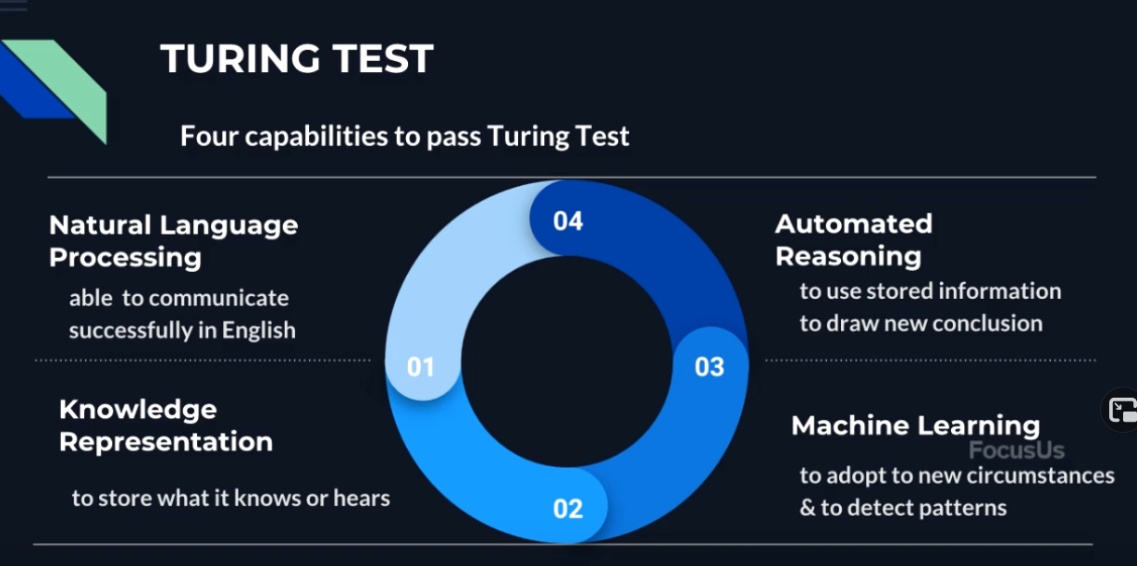

Slide 24
LAWS OF THOUGHT: THINK RATIONALLY
The study of mental faculties through the use of computational models; that it is, the study of the computations that make it possible to perceive, reason, and act.
Focus is on inference mechanisms that are provably correct and guarantee an optimal solution.
Develop systems of representation to allow inferences to be like
“Socrates is a man. All men are mortal. Therefore Socrates is mortal.”
Goal is to formalize the reasoning process as a system of logical rules and procedures for inference.
The issue is, not all problems can be solved just by reasoning and inferences.

Slide 25
RATIONAL AGENT: ACT RATIONALLY
Tries to explain and emulate intelligent behavior in terms of computational processes; that it is concerned with the automation of intelligence.
Focus is on systems that act sufficiently if not optimally in all situations;
It is passable to have imperfect reasoning if the job gets done.
Goal is to develop systems that are rational and sufficient.

